Slide 1



IoT Projects in FLOSS Foundations Dashboard https://iotfloss.bitergia.net/
A dashboard based on communities data v0.1
Alvaro del Castillo <adelcastillo@thingso2.com>
Valerio Cosentino <valcos@bitergia.com>
https://thingso2.com
https://bitergia.com

Slide 2
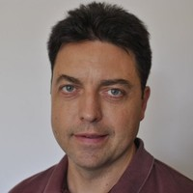
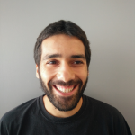
Bring to you by ...
Álvaro del Castillo
<adelcastillo@thingso2.com>
Open Source advocate and developer!
Working now in an IoT platform at ThingsO2
In love with reactive technologies and functional programming
Impressed by the IoT grow and possibilities
PLC4X committer
Valerio Cosentino
<valcos@bitergia.com>
GrimoireLab maintainer, CHAOSS contributor
Working at Bitergia
Interested in source code analysis, ETL processes and reverse engineering
Newbie in the IoT ecosystem

Slide 3
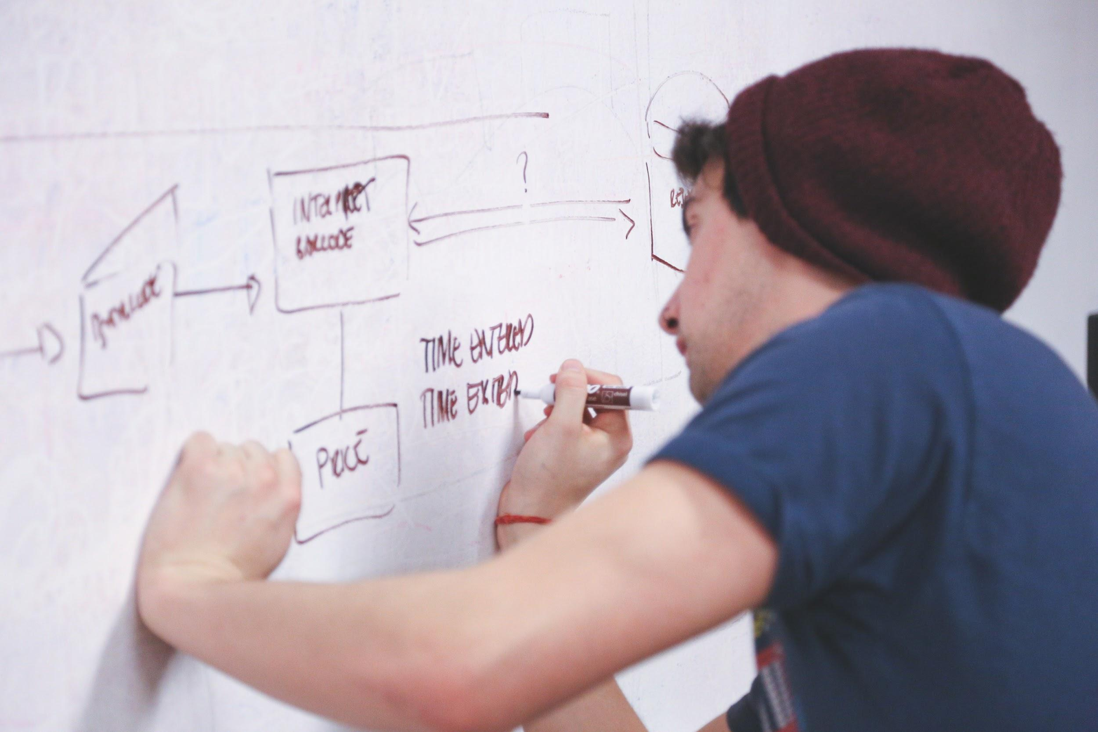
Outline
Overview
IoT architectures
Apache Software Foundation (AF)
Eclipse Foundation (EF)
Linux Foundation (LF)
Project selection and classification
Findings and Insights
Conclusion

Slide 4

Overview
Why
More visibility is needed of what’s happening on the FLOSS IoT landscape. This dashboard provides a place to better understand the IoT ecosystem.
How
The dashboard is made with GrimoireLab, an open source toolset for software development analytics. It’s part of CHAOSS, a project under the Linux Foundation: https://chaoss.github.io/grimoirelab/
Contribute
Have a look at https://github.com/aylabs/iotfloss, and join us!

Slide 5

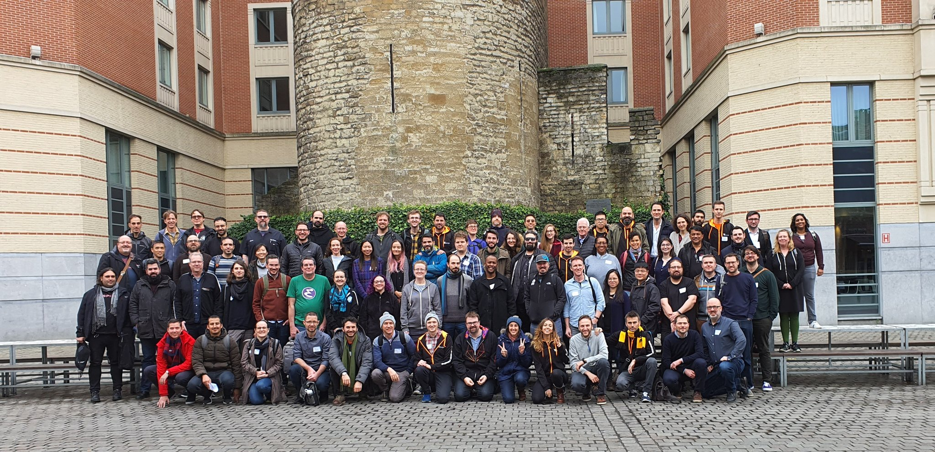
Warnings
Our initial focus was IIoT
We use IoT for simplicity but both are converging
Project selection and classification are debatable
Both are the pillars of the dashboard
Basic metrics in this version
CHAOSS project could help in future releases
All data you will see have CC by licenses when possible
The data owners are the projects

Slide 6

Selecting and comparing IoT projects
Mature projects included in FLOSS Foundations
Apache Software Foundation (ASF), Eclipse Foundation (EF) and Linux Foundation (LF)
Why: they follow quality rules for project adoption
Comparison based on categories
The categories are derived from the analysis of different IoT platforms in terms of vision and strategy and implementation
Foundations are compared based on the categories results
Metrics: changes in code (commits) and community size

Slide 7

IoT platforms
IoT Platforms include all the systems needed to manage industrial deployments in sectors like Oil & gas, Automotive, Aerospace, Transportation & Traffic, Energy or Manufacturing
The predicted market is huge for IoT USD 751.3 billion by 2023 (>20% grow/year)
Nowadays there are a great number of IoT platforms fighting to become one of the final references in the market
Architectures are well defined and are close to be standardized: good to organize IoT technologies in a common map based on categories

Slide 8

IoT platforms: basic features
Device Management
Support for protocols
Integration
Data Management
Analytics
Management of Applications
Security Audits
Robustness
Flexibility with low-code interfaces
Cloud computing, On-premises and Fog/Edge computing support
https://www.iotworldtoday.com/2019/08/07/top-10-iiot-platforms/

Slide 9
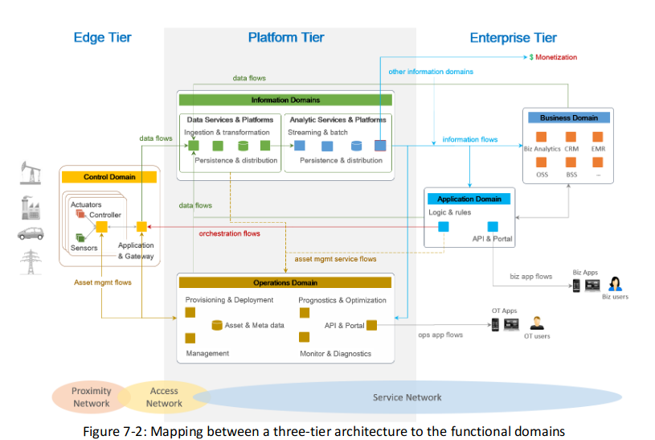
IoT platforms: architecture (IIRA by IIC)

Slide 10
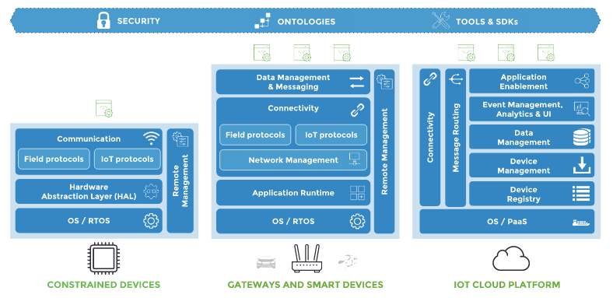
IoT platforms: Eclipse Foundation

Slide 11
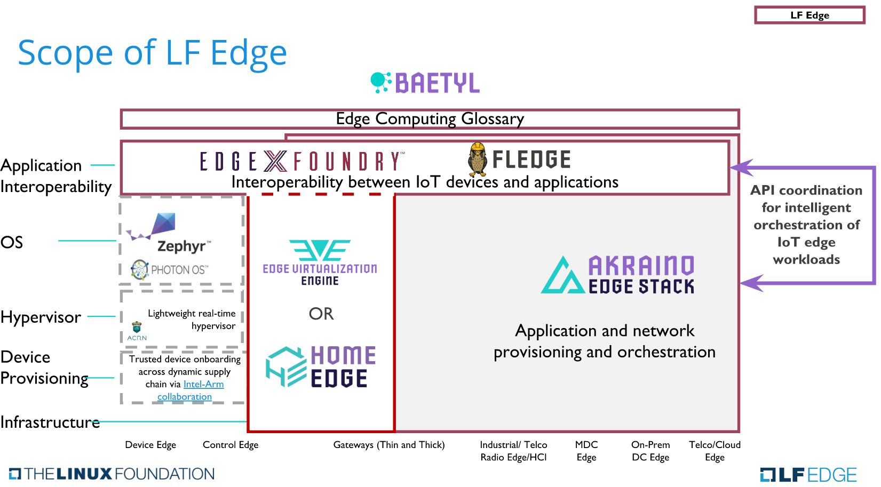
IoT platforms: Linux Foundation

Slide 12
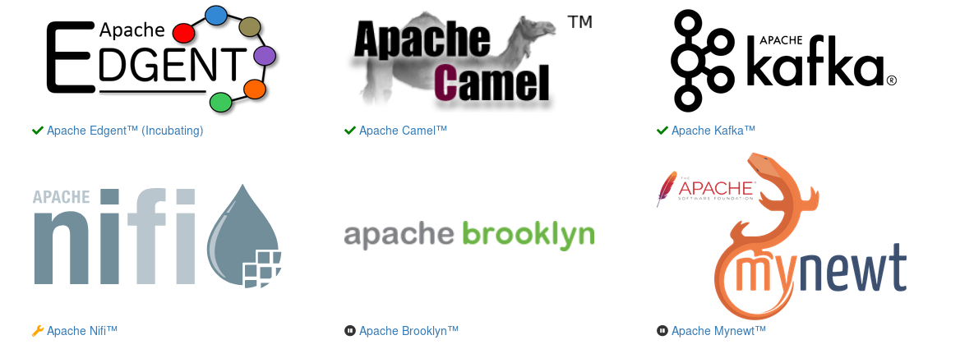
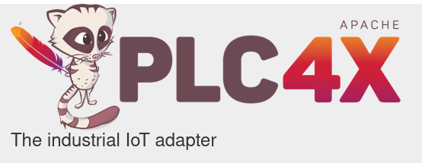
IoT platforms: ASF
Apache does not have an IoT strategy. It has emerged in some way from the projects that joined the Foundation
Apache IoT projects as seen by PLC4x project (2019)

Slide 13

Projects Classification
OS & virtualization
Protocol
Integration/Gateway
Processing
Persistence
Framework
Platform
Application
Fog
Ecosystem

Slide 14
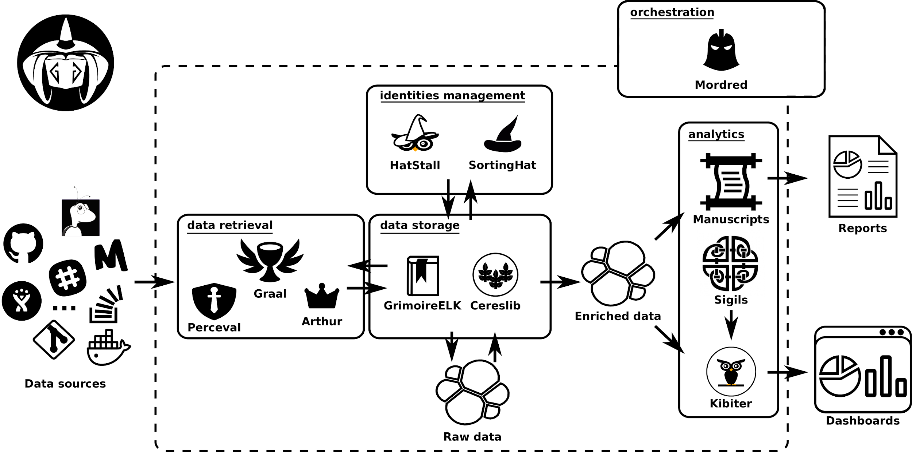
Findings and insights: GrimoireLab

Slide 15
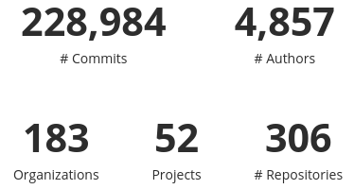
Findings and insights: https://iotfloss.bitergia.net
The next slides showcase details for the last 10 years (until past Wednesday!)

Slide 16
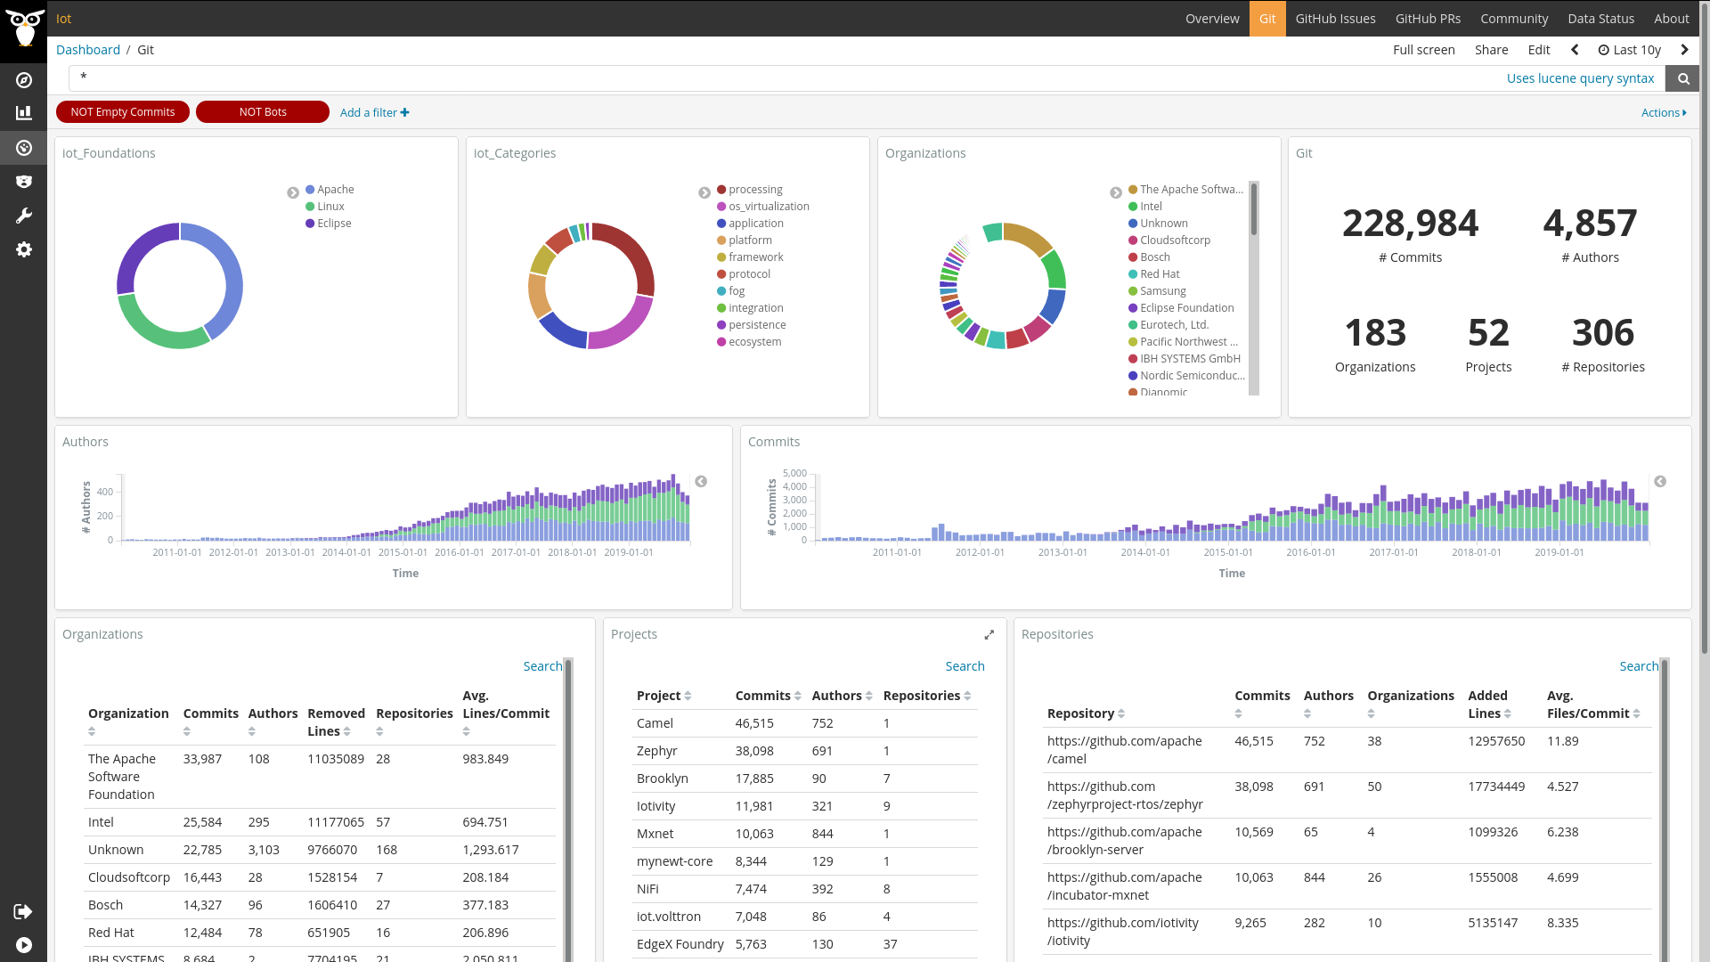
Findings and insights: Global metrics

Slide 17

Findings and insights: Git activity
Large community: 5K authors and 200 organizations
Balanced number of commits between Foundations
ASF started first (2007) and then EF and LFN (2011)
EF accounts for 33 projects, followed by LF (11) and ASF (8)
Top 5 organizations by projects:
ASF (16), Bosch (13), Intel (10), Red Hat (9) and Cloudsoft (7)
Top 5 projects:
Camel (ASF), Zephyr (LF), Brooklyn (ASF), IoTivity (LF) and MxNet (ASF)

Slide 18
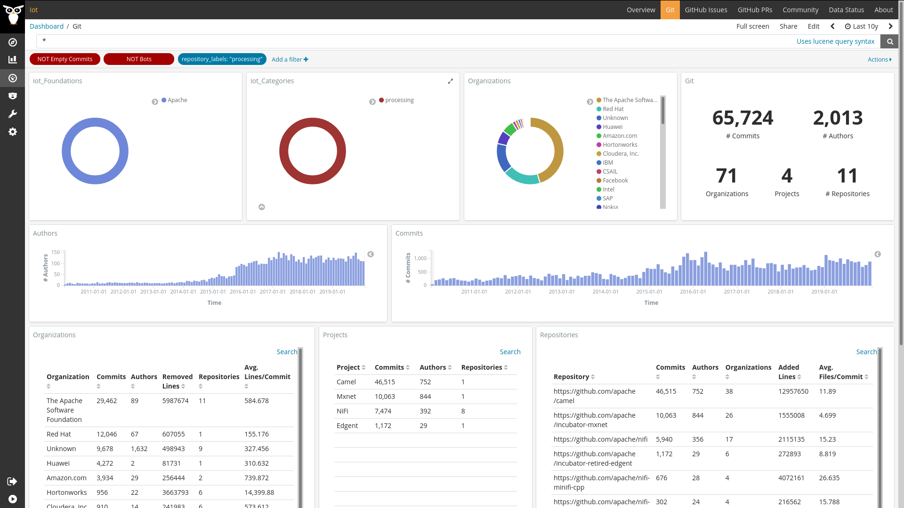
Processing

Slide 19
Processing
Large community: 2K authors and 70 organizations (1/3 of the total numbers approx)
Community and activity numbers stable the last 3 years
ASF is leading this category: all projects from ASF (strong Big data projects)
Cloud related projects are selected since used also in the Edge for IoT data processing
Large companies participation:
Redhat, Huawei, Amazon, Hortonworks + Cloudera, IBM, CSAIL (MIT AI), Facebook, Intel, SAP and Nokia

Slide 20
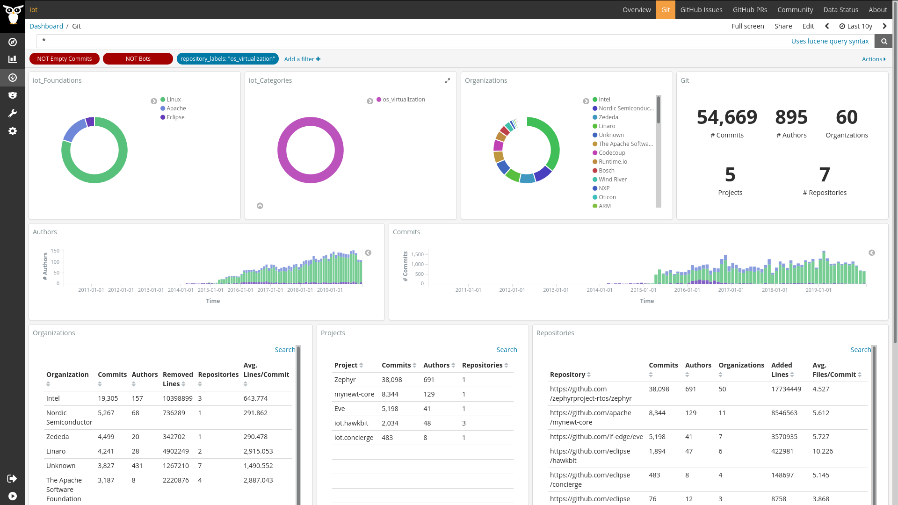
OS & Virtualization

Slide 21
OS & Virtualization
Large community: 1K authors and 60 organizations (20% total)
RTOS and virtualizations for embedded devices, integration (OSGi) and deploy platforms
Zephyr is “close” to Linux and it is huge. eVe is Linux EdgeX core. Apache has MyNewt and it is incubating Nuttx, another RTOS. Eclipse is focused in integration and deployment technologies, without a RTOS.
Intel, Nordic and Linaro are leading Zephyr orgs, and Zededa is behind LF eVe. Codecoup is working in both Zephyr and MyNewt!
Linux is leading this category

Slide 22
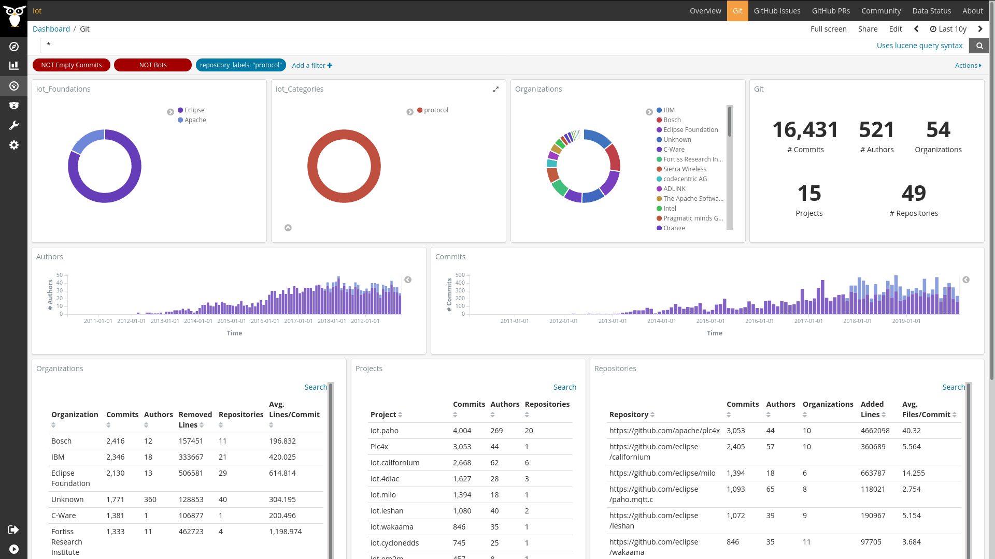
Protocol

Slide 23
Protocol
Medium community: 500 authors and 54 organizations
(10% total) and 15 projects.
Eclipse is working in several protocols related implementations like MQTT, COAP, OPC-UA … Apache has PLC4x, the largest project offering a common API for all industrial protocols. Linux protocols support is inside the projects like EdgeX.
IBM (mqtt), Bosch, C-Ware, Fortiss and Sierra Wireless are the top companies in this category
Eclipse is leading this category

Slide 24
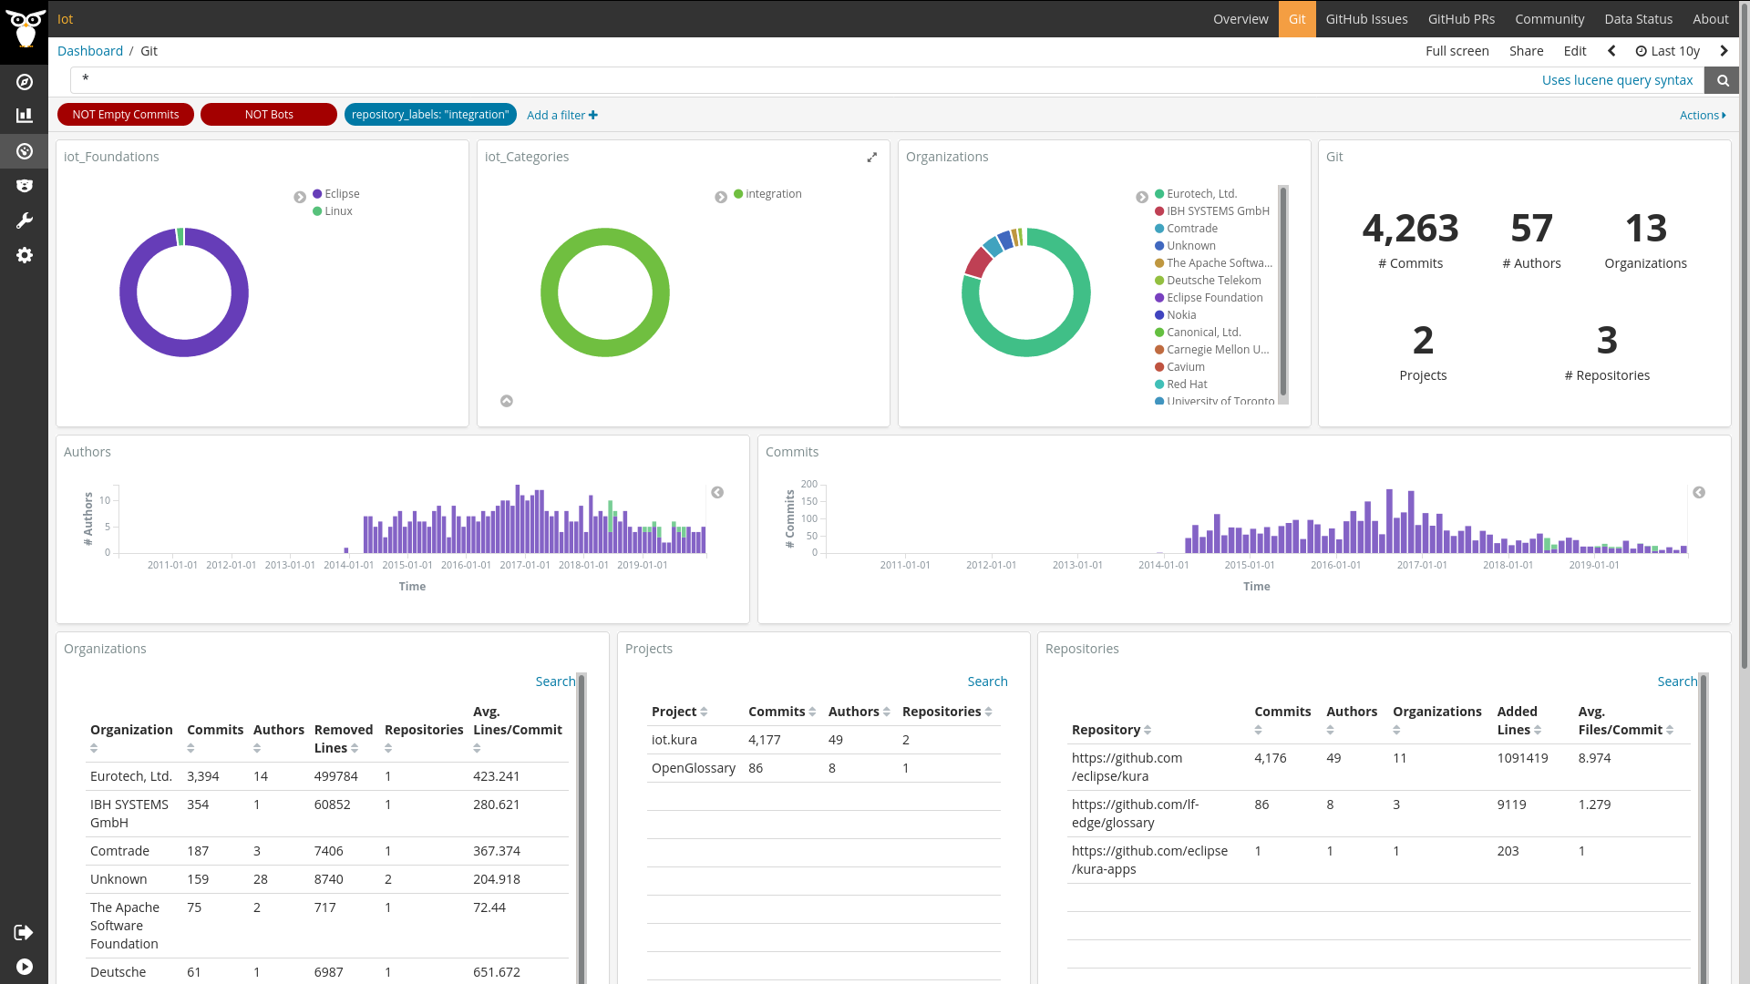
Integration/Gateway

Slide 25
Integration/Gateway
Small community based on from Eurotech organization
An integration platforms to be deployed in IoT gateways. At the code of Eurotech IIoT platform
Collaborating with Eurotech there are IBH Systems, Comtrade and Deutsche Telecom
NodeRED has not being analyzed but it is the other FLOSS alternative
Eclipse is leading this category

Slide 26
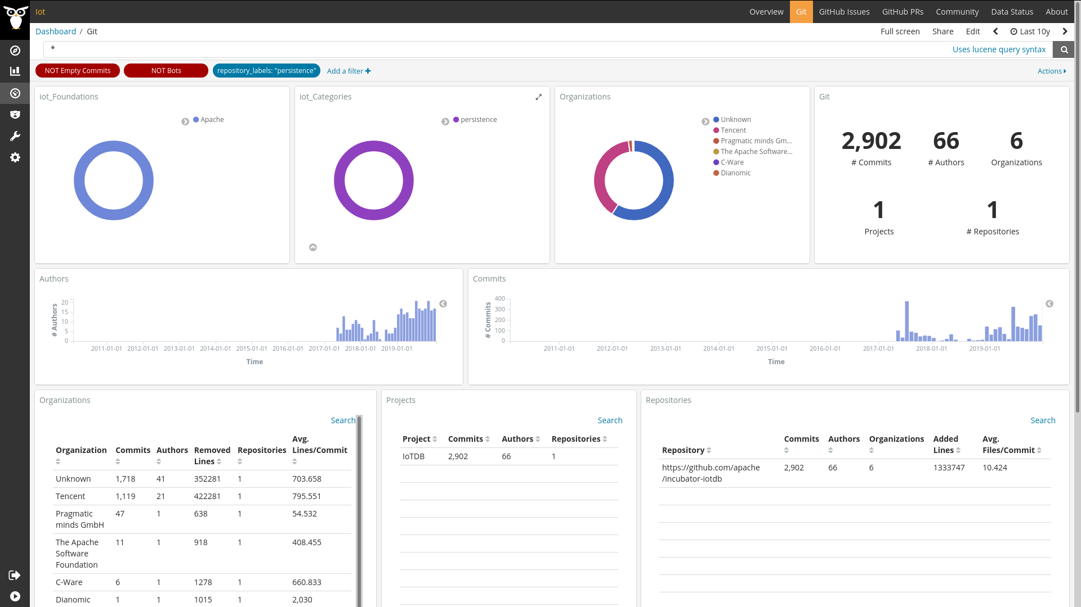
Persistence

Slide 27
Persistence
Small community from the creators of Apache IoTDB (Tencent and Pragmatic minds organizations)
There are others projects that could be included because its relation with IoT like Apache Calcite
This is persistence in the Edge
Apache is leading this category

Slide 28
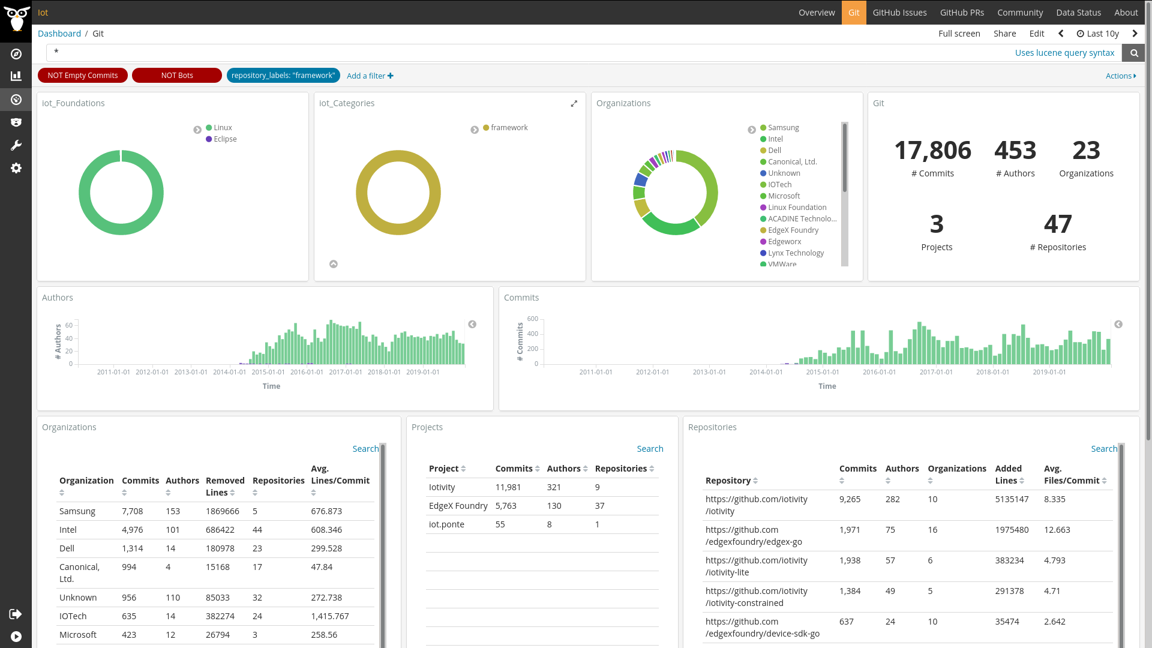
Framework

Slide 29
Framework
Medium community: 500 authors and 23 organizations (10% total)
Frameworks that are useful to build IoT platforms and services
IoTivity is “close” to Linux but closer now to Open Connectivity Foundation to implement its standards and it is closer to smart-home.
Eclipse Ponte is a kind of gateway so it could be moved to Protocols
And EdgeX is the flagship of LF Edge strategy. Contributed by Dell, it has now strong players like Canonical, Intel and IOTech developing it. It has a strong grow in the number of authors and in the activity.
Linux is leading this category

Slide 30
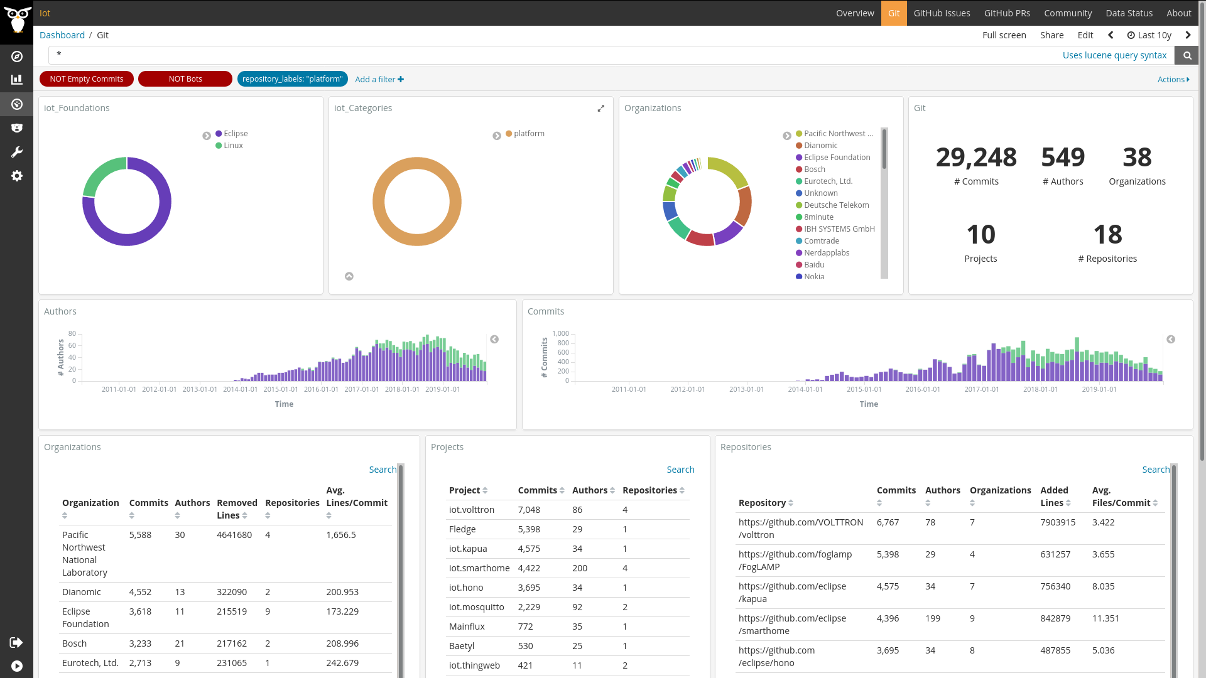
Platform

Slide 31
Platform
Medium community: 500 authors and 38 organizations (10% total)
IoT complete platforms like Linux Fledge but also IoT systems like MQTT (Eclipse Mosquitto) and others. Apache is missing.
Close to out of the box technology which can be directly used
Eclipse Volttron, Kapua, Smarthome and Hono projects are leading this category, with Linux Fledge.
Pacific Nordwest, Dianomic, Bosch, Eurotech and Deutsche Telecom are leading the category
Eclipse is leading this category

Slide 32
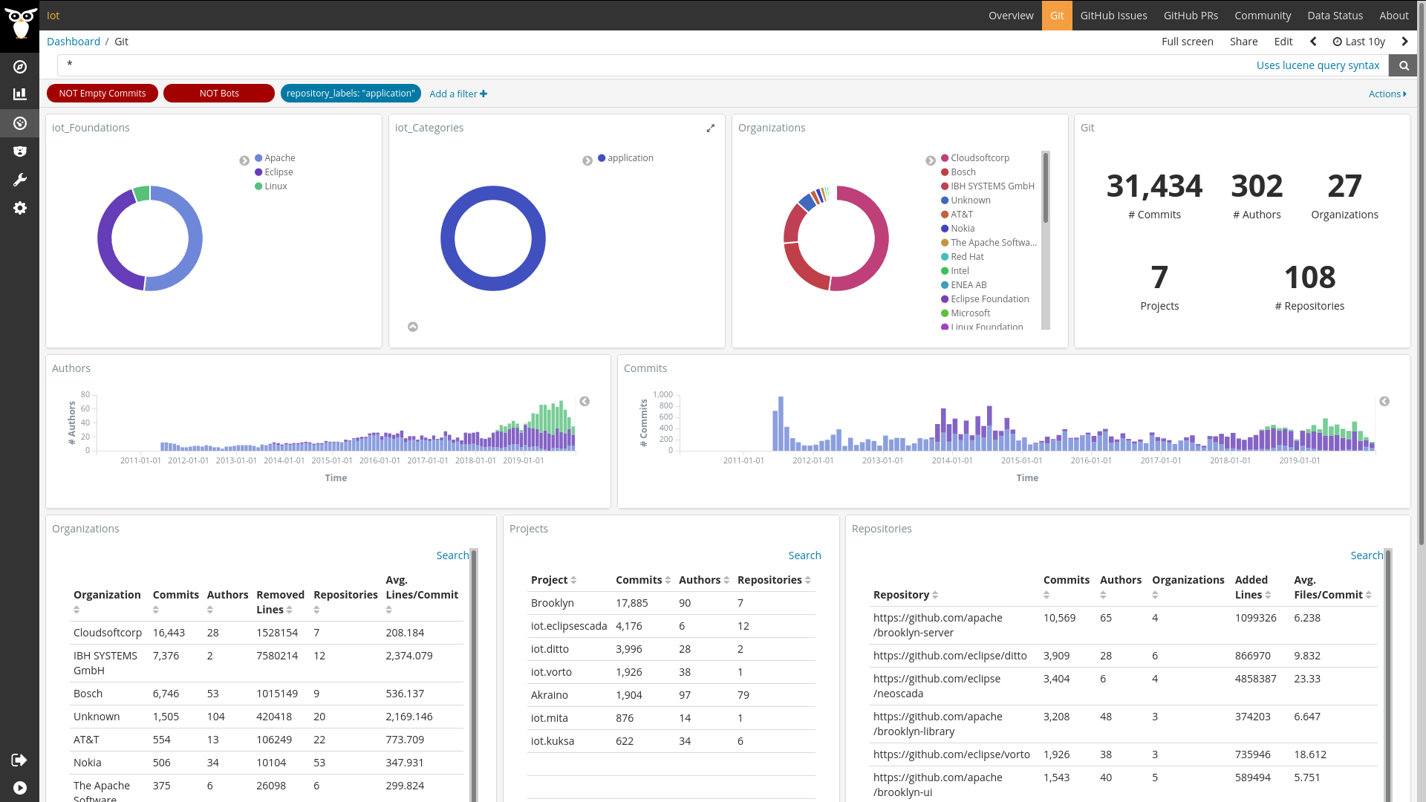
Application

Slide 33
Application
Medium community: 300 authors and 30 organizations (5% total)
IoT platforms to deploy application on them and final applications like digital twin
Cloudsoftcorp, Bosch and IBH Systems are leading the category with their projects Apache Brooklyn, Eclipse Ditto/Vorto/Mita/Kusa and Eclipse Scada
In this category Bosch shows its strength in Open Source IoT
Eclipse is leading this category

Slide 34
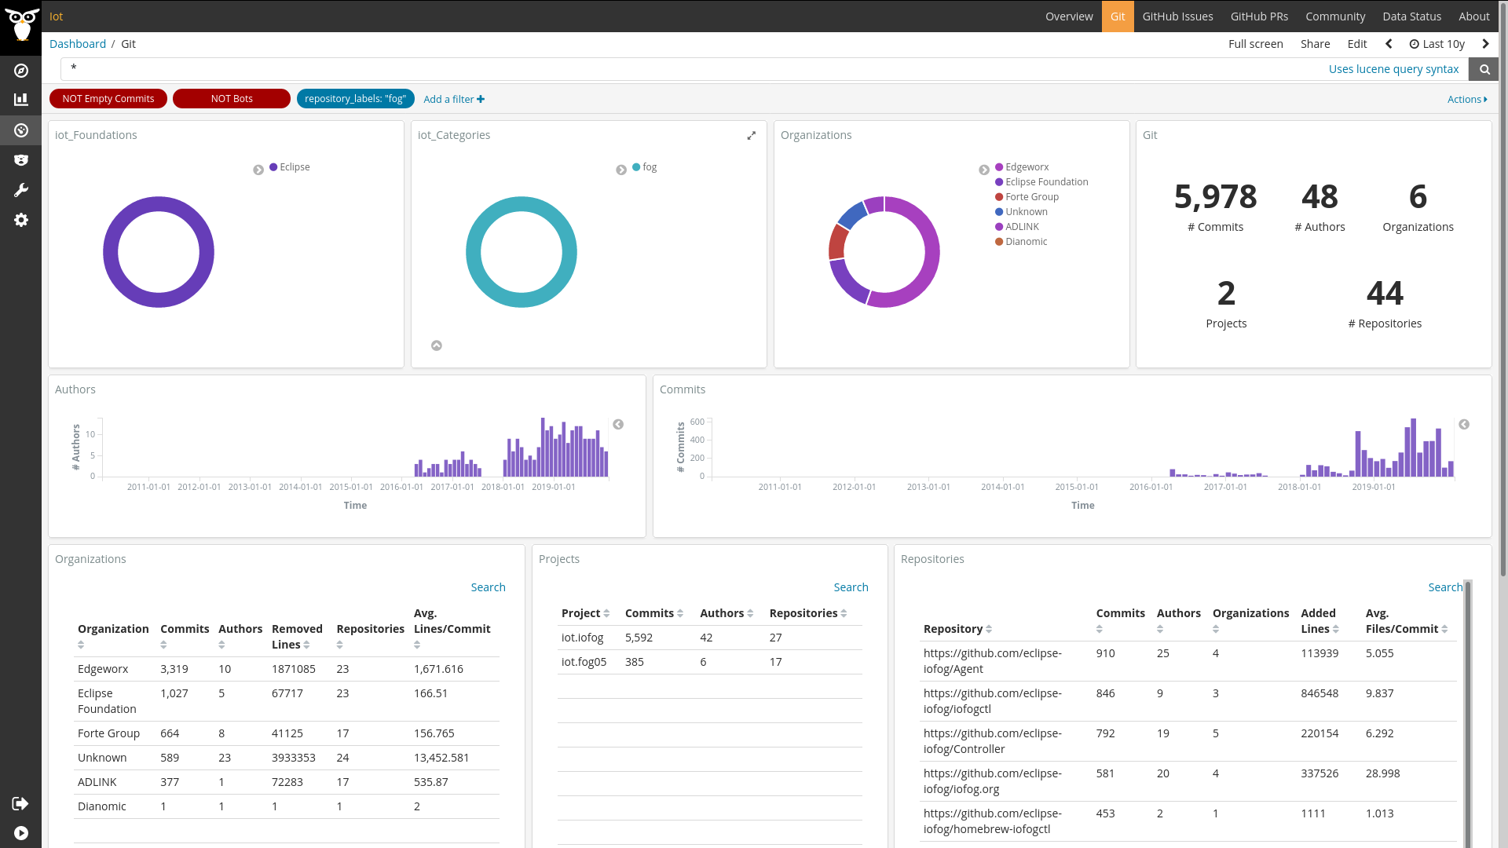
Fog

Slide 35
Fog
Small community: Eclipse projects for the fog in which are based the Eclipse Edge Native Working Group
A category to be reviewed to be merged in platforms or frameworks probably
ioFog is the main project lead by EdgeWorkx
And of course, Eclipse is leading this category ;)

Slide 36
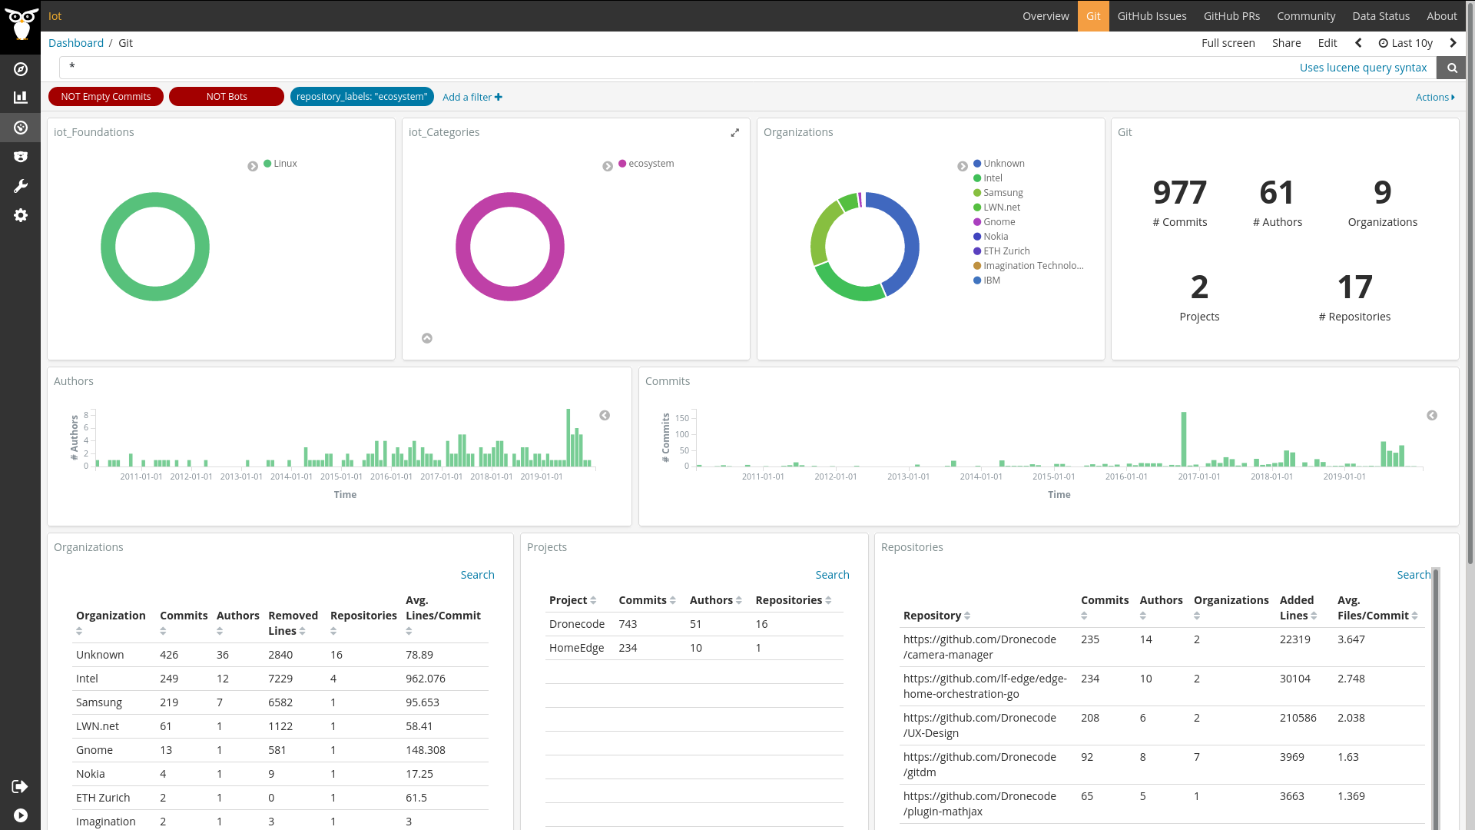
Ecosystem

Slide 37
Ecosystem
In this category there are two projects hard to classify in others: Dronecode and HomeEdge.
HomeEdge is a home edge computing framework.
Dronecode mission is “Building a sustainable open source ecosystem for critical Drone components”
Intel and Samsung are the main contributors in this category.
Linux is leading this category

Slide 38
Findings and insights: Summary
Category | Foundation | Com Size | Project | Companies
Processing | ASF | L | Camel | Red Hat, Huawei, Amazon
OS & virtualization | LF | L | Zephyr | Intel, Nordic, Zededa
Protocol | EF | M | Paho | IBM, Bosch, C-Ware
Integration/gateway | EF | S | Kura | Eurotech, IBH Systems, Comtrade
Persistence | ASF | S | IoTDB | Tencent, Pragmatic minds
Framework | LF | M | IoTivity | Samsung, Intel, Dell
Platform | EF | M | Volttron | Pacific Northwest, Dianomic, Bosch
Application | EF | M | Brooklyn | Cloudsoft, Bosch, IBH Systems
Fog | EF | S | IoFog | EdgeWorX, Forte Group, ADLink
Ecosystem | LF | S | Dronecode | Intel, Samsung, Nokia

Slide 39

Conclusion: And the winner is … FLOSS
Apache is strong in data: persistence, processing and communications. Its Big Data position is probably the reason. It does not have a strong IoT strategy but it is attracting IoT projects naturally.
Eclipse has the richer IoT projects ecosystems, it is present in most of the categories and leading them. And it has strong industrial support like Bosch or Eurotech.
Linux is favored by “close” projects like Zephyr and IoTivity, but its Edge strategy is attracting big projects like EdgeX, Fledge, eVe or Akraino and more are coming.

Slide 40

Checking the coverage of the data
In the PAC Radar of IoT platforms based on Open Source in Europe 2019 analyzing best companies in the market:
Bosch and Eurotech (leaders) are working in EF
Mainflux (second position with other 3) is working in LF
So foundations are attracting the big Open Source players at least in Europe
Mozilla Foundation IoT with its Web Things platform is on the radar

Slide 41

Collaborations between projects
Apache PLC4x using Eclipse Milo, Eclipse Ditto and others
People from Apache working in other Foundations
Eclipse Kura uses Apache Camel
How to find these collaborations?
How to promote them?
This dashboard helps offering visibility
The FOSDEM IoT devroom attracts communities together!

Slide 42

Takeaways
The IoT landscape is full of FLOSS projects, where
foundations such as ASF, LF, EC and big companies
(Bosch, Intel, Eurotech, ...) are actively involved
Where is the dashboard? https://iotfloss.bitergia.net/
Can I contribute? YES https://github.com/aylabs/iotfloss
Help us by suggesting new classifications, projects and insights!

Slide 43


@acstw
@_valcos_

Slide 44
Image Credits
https://www.pexels.com/photo/ask-blackboard-chalk-board-chalkboard-356079/
https://www.pexels.com/photo/woman-sharing-her-presentation-with-her-colleagues-3153198/
https://www.pexels.com/photo/silhouette-photography-of-group-of-people-jumping-during-golden-time-1000445/
https://www.pexels.com/photo/abstract-bright-colorful-cover-268941/
https://www.pexels.com/photo/action-adult-athlete-blur-213775/
https://www.pexels.com/photo/black-binocular-on-round-device-63901/
https://www.pexels.com/photo/depth-of-field-photography-of-file-arrangement-1181772/
https://www.pexels.com/photo/close-up-photo-of-tied-blue-box-1178562/
https://www.pexels.com/photo/bird-s-eye-view-photography-of-city-2960007/
https://www.pexels.com/photo/person-holding-magnifying-glass-712786/
https://www.pexels.com/photo/sign-slippery-wet-caution-4341/
https://www.pexels.com/photo/analysis-blackboard-board-bubble-355952/
https://www.pexels.com/photo/man-wearing-blue-crew-neck-top-7367/
https://twitter.com/MishManners/status/1223216638951952386

